Slide 1
Warehouse Schema
Samuel OCEN
E MAIL: - samuel.ocen@mmu.ac.ug
samuel.ocen@student.uonbi.ac.ke
MOB: - +256(0)775 679 505
+256(0)706 109 393

Slide 2
Normalization
Normalization is a technique that helps in organizing the data in the database.
The main purpose of normalizing the data is to remove redundancy from the relation.
Normalization divides the table into smaller tables while normalizing the table.

Slide 3
Types of Normalization.
First Normal Form (1NF)
The simplest kind of Data Normalization is 1NF, which assures that no two entries in a group are identical. The following rules must be followed for a table to be in the first normal form:
Each cell should only have one value.
Each record should be distinct from the others.
Second Normal Form (2NF)
All subsets of data that can be placed in multiple rows are placed in distinct tables in a 2NF table. The following rules must be followed for a table to be in the second normal form:
It should be in the 1NF.
Any subset of Candidate keys should not be functionally dependent on the Primary key.
It’s obvious that you won’t be able to move further with creating a simple database in 2NF unless you partition the table above.

Slide 4
Types of Normalization Continue.
Third Normal Form (3NF)
The following rules must be followed for a table to be in the 3NF:
It should be in the 2NF.
It should not have any functional dependencies that are transitive.
A Transitive Functional dependency occurs when a change in one column (that isn’t a primary key) affects all of the other columns.

Slide 5
Star Schema
Star schema is the fundamental schema among the data mart schema, and it is simplest.
This schema is widely used to develop or build a data warehouse and dimensional data marts.
It includes one or more fact tables indexing any number of dimensional tables.
The star schema is a necessary cause of the snowflake schema. It is also efficient for handling basic queries.

Slide 6
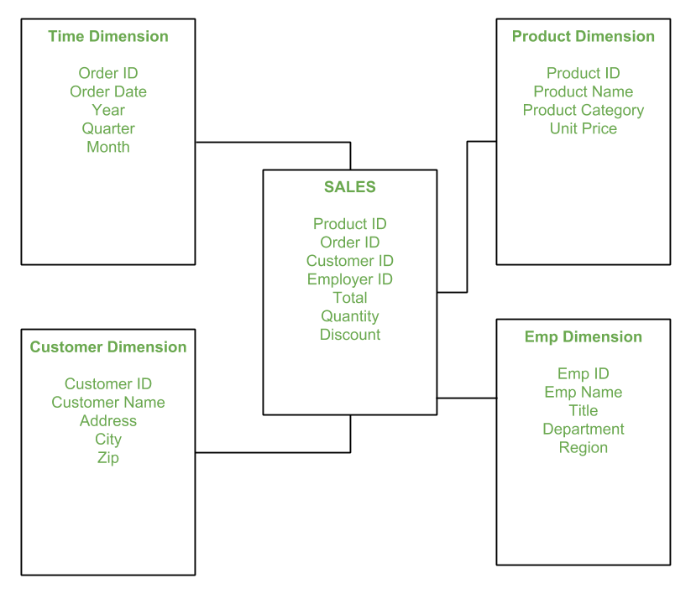
Example of a star schema.
In the above demonstration, SALES is a fact table having attributes i.e. (Product ID, Order ID, Customer ID, Employer ID, Total, Quantity, Discount) which references to the dimension tables. Employee dimension table contains the attributes: Emp ID, Emp Name, Title, Department and Region. Product dimension table contains the attributes: Product ID, Product Name, Product Category, Unit Price. Customer dimension table contains the attributes: Customer ID, Customer Name, Address, City, Zip. Time dimension table contains the attributes: Order ID, Order Date, Year, Quarter, Month.

Slide 7
Model of Star Schema
In Star Schema, Business process data, that holds the quantitative data about a business is distributed in fact tables, and dimensions which are descriptive characteristics related to fact data. Sales price, sale quantity, distant, speed, weight, and weight measurements are few examples of fact data in star schema. Often, A Star Schema having multiple dimensions is termed as Centipede Schema. It is easy to handle a star schema which have dimensions of few attributes.

Slide 8
Advantages of Star Schema
Simpler Queries – Join logic of star schema is quite cinch in comparison to other join logic which are needed to fetch data from a transactional schema that is highly normalized.
Simplified Business Reporting Logic – In comparison to a transactional schema that is highly normalized, the star schema makes simpler common business reporting logic, such as of reporting and period-over-period.
Feeding Cubes – Star schema is widely used by all OLAP systems to design OLAP cubes efficiently. In fact, major OLAP systems deliver a ROLAP mode of operation which can use a star schema as a source without designing a cube structure.

Slide 9
Disadvantages of Star Schema
Data integrity is not enforced well since in a highly de-normalized schema state.
Not flexible in terms if analytical needs as a normalized data model.
Star schemas don’t reinforce many-to-many relationships within business entities – at least not frequently.

Slide 10
Snowflake Schema
The snowflake schema is a variant of the star schema. Here, the centralized fact table is connected to multiple dimensions. In the snowflake schema, dimensions are present in a normalized form in multiple related tables. The snowflake structure materialized when the dimensions of a star schema are detailed and highly structured, having several levels of relationship, and the child tables have multiple parent tables. The snowflake effect affects only the dimension tables and does not affect the fact tables.

Slide 11
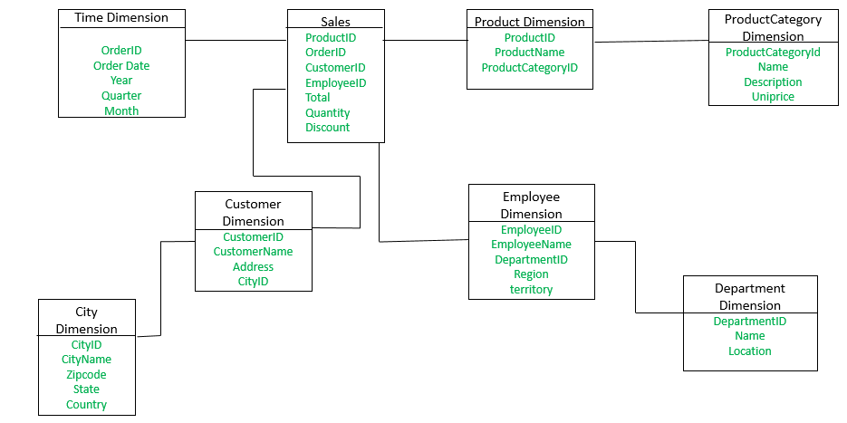
Example
The Employee dimension table now contains the attributes: EmployeeID, EmployeeName, DepartmentID, Region, Territory. The DepartmentID attribute links with the Employee table with the Department dimension table. The Department dimension is used to provide detail about each department, such as the Name and Location of the department. The Customer dimension table now contains the attributes: CustomerID, CustomerName, Address, CityID. The CityID attributes link the Customer dimension table with the City dimension table. The City dimension table has details about each city such as CityName, Zipcode, State, and Country.

Slide 12
Difference between snowflake and star schema
The main difference between star schema and snowflake schema is that the dimension table of the snowflake schema is maintained in the normalized form to reduce redundancy. The advantage here is that such tables (normalized) are easy to maintain and save storage space. However, it also means that more joins will be needed to execute the query. This will adversely impact system performance.

Slide 13
Snowflake Continues
What is snowflaking? The snowflake design is the result of further expansion and normalized of the dimension table. In other words, a dimension table is said to be snowflaked if the low-cardinality attribute of the dimensions has been divided into separate normalized tables. These tables are then joined to the original dimension table with referential constraints (foreign key constrain). Generally, snowflaking is not recommended in the dimension table, as it hampers the understandability and performance of the dimension model as more tables would be required to be joined to satisfy the queries.
Characteristics of snowflake schema: The dimension model of a snowflake under the following conditions:
The snowflake schema uses small disk space.
It is easy to implement dimension that is added to the schema.
There are multiple tables, so performance is reduced.
The dimension table consists of two or more sets of attributes that define information at different grains.
The sets of attributes of the same dimension table are being populated by different source systems.

Slide 14
Advantages
There are two main advantages of snowflake schema given below:
It provides structured data which reduces the problem of data integrity.
It uses small disk space because data are highly structured.
Disadvantages
Snowflaking reduces space consumed by dimension tables but compared with the entire data warehouse the saving is usually insignificant.
Avoid snowflaking or normalization of a dimension table, unless required and appropriate.
Do not snowflake hierarchies of one dimension table into separate tables. Hierarchies should belong to the dimension table only and should never be snowflakes.
Multiple hierarchies that can belong to the same dimension have been designed at the lowest possible detail.

